Slide 1
CRAFT BREWERY DEMOGRAPHIC STUDY
We were interested in digging into what is driving the growth in the craft beer market, and how we could use that data to ensure the continued growth of the market
Notes:
Definition of Craft Brewer --- A brewer that has a majority of its total beverage alcohol volume in beers whose flavors derive from traditional or innovative brewing ingredients and their fermentation. Usually small volume

Slide 2
Hypothesis:
We believed that sanctuary cities would have greater growth potential than non- sanctuary cities
Null Hypothesis:
There is no correlation between target demographics and sanctuary and non- sanctuary cities

Slide 3
Questions Needed Answering
What would be the target demographic?
Where is that target demographic located at?
Where is a sanctuary city and non sanctuary city located with similar characteristics?
What Craft Breweries are located in the region?
What distribution centers are located in the region?
Notes:
Any limitations on alcohol rules within the state or counties?

Slide 4
Data Utilized
Demographic information pulled from Brewers Association specifically the article Shifting Demographics Among Craft Drinkers
Census Data
Kaggle for List of Craft Breweries in the United States
Mapquest API for Latitude, Longitude, and County name for Breweries as well as Grocery locations in San Antonio and Houston
Plotly to create Choropleth and Plots

Slide 5
General Assumptions
In effort to save time we made the following assumptions/inferences:
Brewers Association Data:
Data is unbiased and correct
It uses recent population estimates to determine percentages
List of Breweries did not include every location, just central
Data Limitations:
Last Census was done in 2010
Used Census estimated population statistics from 2016
Would have been $500 for membership, or two week request to get data from Brewers Association. Had to go forward with their findings
Notes:
Most Assumptions were due to time constraints

Slide 6
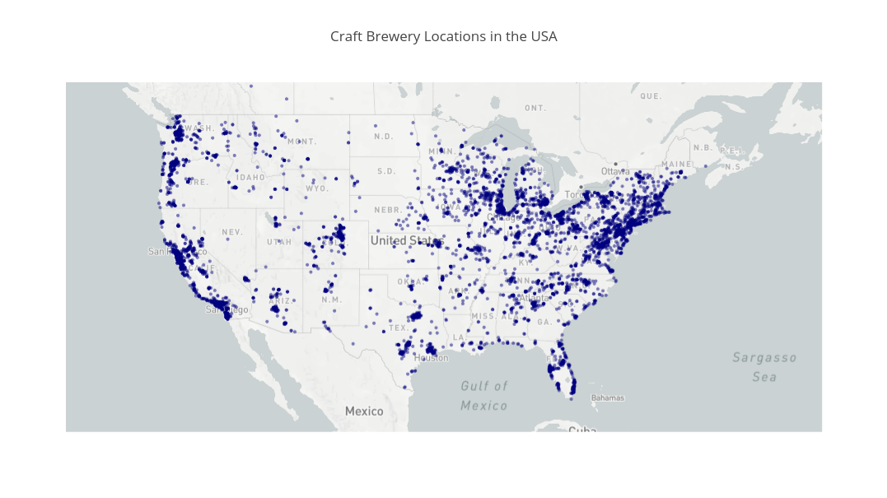
Notes:
Opacity in plots to also show Brewery density
Also shows traditional brewery hotspots have redistributed
Made on plotly

Slide 7
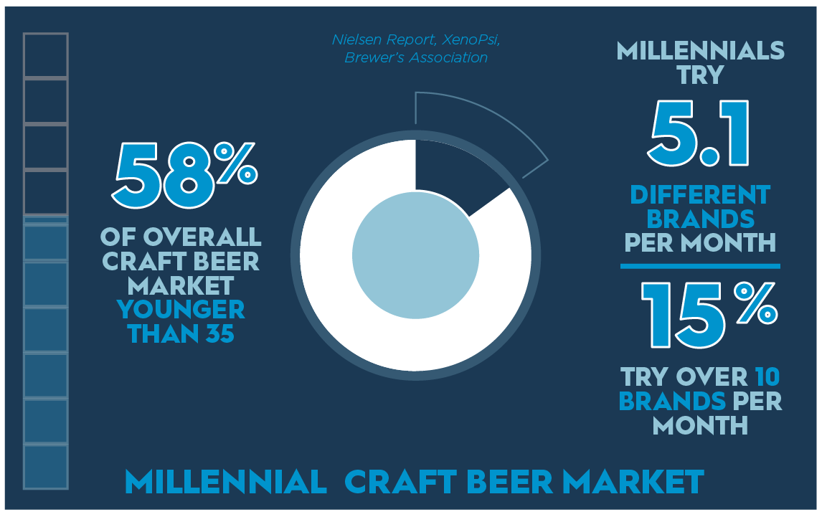
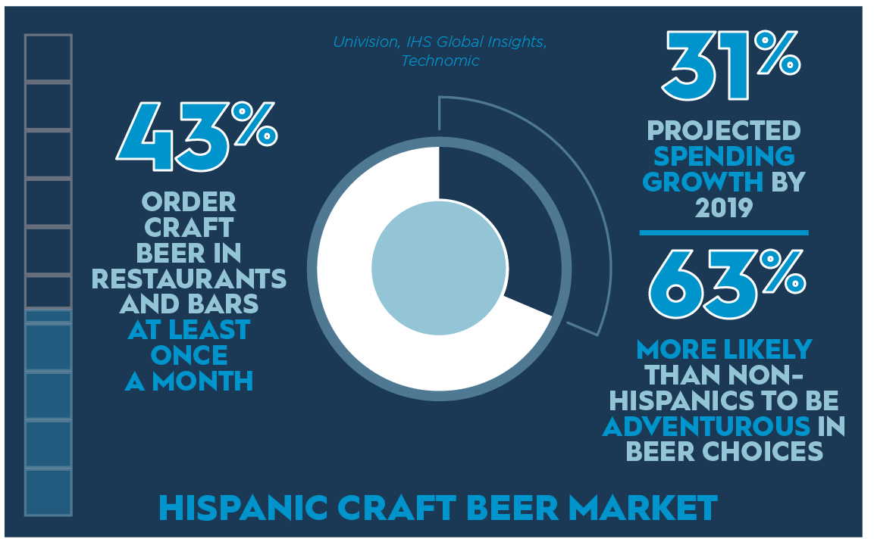
Changing Demographics
Males still continue to make up majority
Higher Socio Economic Status (SES)
But there are two demographics that are helping shape the craft beer markets…
Notes:
https://www.craftbrewingbusiness.com/featured/understand-age-changing-demographics-craft-beer-drinkers-market-properly/
~ 70% are males

Slide 8
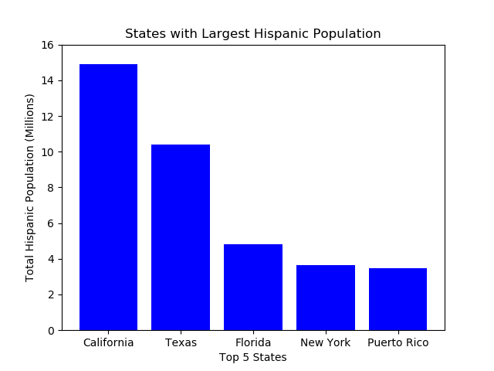
Census Data Exploration and Cleaning
Obtained from US Census Bureau Total Population by State (Hispanic Population)
Cross referencing the above states that contain sanctuary cities we find Texas has a non sanctuary city and sanctuary city close in latitude and population.
HOUSTON (SANCTUARY) VS SAN ANTONIO (NON SANCTUARY)
Notes:
Able to generate a CSV file that could then use Python to analyze
- Little cleaning required mostly on header information.
Generated using Matplotlib

Slide 9
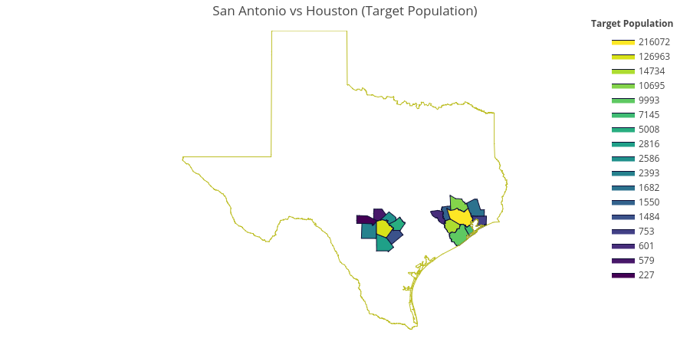
Results for Target Population
Harris County (Houston) – 216,072
Bexar County (San Antonio) – 126,963
Fort Bend (Houston) - 14,734

Slide 10
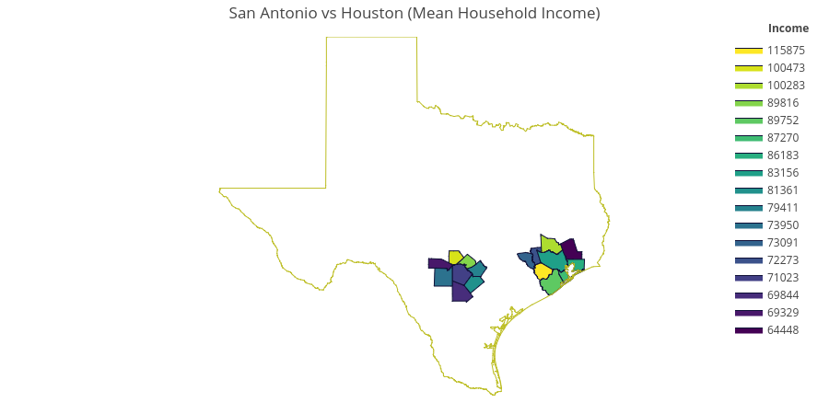
Results for Total Household Income (Mean)
Fort Bend (Houston) – $115,875 (3rd in Target Population)
Kendall (San Antonio) – $100,473 (16th in Target Population)
Montgomery (Houston) - $100,283 (4th in Target Population)
Notes:
Harris county is 8th in income
Bexar county 14th in income
US Census report~ $60,000 US average

Slide 11
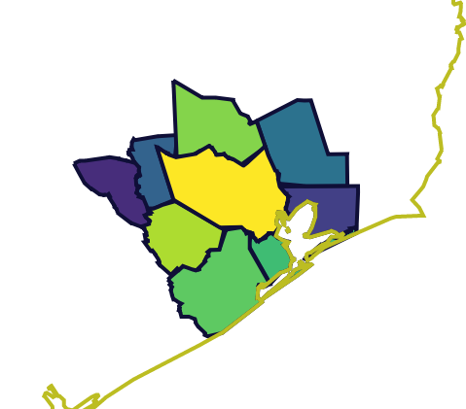
Focus on Houston
Cities to Explore:
Montgomery (Top)
11,000 Population
$100,000 Income
Harris County (Middle)
216,000 Population
$83,000 Income
Fort Bend (Lower)
15,00 Population
$116,000 Income
Notes:
Houston city is located in the center of Harris County

Slide 12
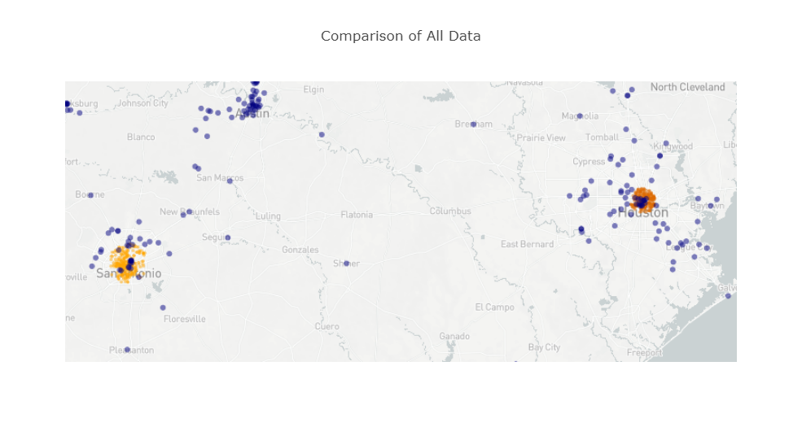
Orange – Grocery Stores
Blue - Breweries

Slide 13
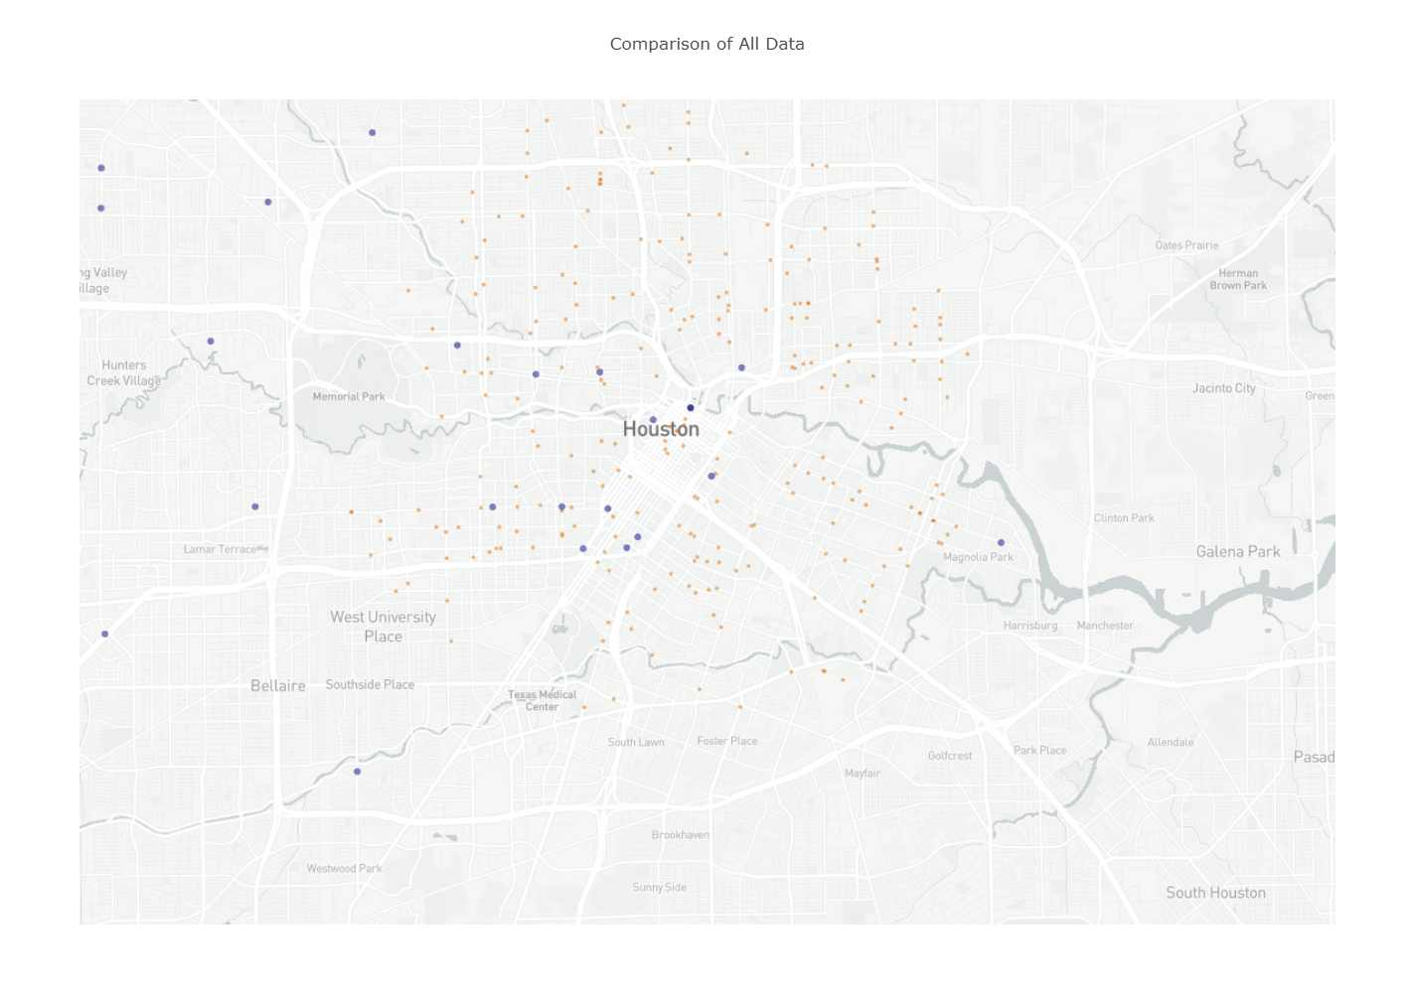
Notes:
Huge area to be used for distribution/brick and mortar locations in Harris County (North of Houston)

Slide 14
Findings and Recommendation
Census Findings
Houston (Montgomery, Harris, and Fort Bend) have high population of our Target Demographic and high SES
Brewery Findings
Most Breweries in Houston are either Downtown or sporadically placed throughout the suburbs
Potential opportunity exists in the Northern Parts of Houston.
Limited number of Breweries in North Houston and Montgomery County
Grocery Store Findings
Liquor Laws in Texas prohibit liquor sales in Grocery Stores (beer is allowed), and based on the density in Montgomery and Harris Counties we believe distribution in that area would be a good place to start

Slide 15
Next Steps/Considerations
Conduct Surveys/Research in Area
Research why Breweries not in area identified.
Identify price sensitivities in market.
Identify type of Craft Beer. (IPA, Sour, Cider, Lager, etc.)
Identify Craft Beer manufactures to present data and findings.
Expand a current Brew Pub to area or only use local establishments to distribute?
Rerun demographics after 2018 Census to see if findings change
Research preferred purchase method for Beer in Texas.
Notes:
Ball’s Brewery (Hopslam)

Slide 16
Question and Answer

Slide 17
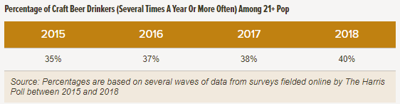
Craft Beer Drinkers Demographics
Demographics Historically
Males
Higher Socio Economic Status (SES)
Late 30’s Age Group
Non Hispanic Population
Notes:
https://www.brewersassociation.org/insights/shifting-demographics-among-craft-drinkers/

Slide 18
Houston vs San Antonio Census Data
Obtained from US Census Bureau Texas Population Statistics for the following:
Age Demographics
Race Demographics
Sex Demographics
Income Demographics
Cleaning of Data
Read and Merging files
Adding Calculations for Target Population
Formatting data
Creation of new Data Frame’s for only counties pertaining to Houston or San Antonio
Generation of maps by Target Population and Household Income (Mean) using GEO ID
Notes:
Able to generate a CSV file that could then use Python to analyze
- Data presented by County and contained GEO ID
- Required merging 4 data sets into one
- Then created new dataFrame with only San Antonio and Houston
- Little cleaning required mostly on header information.

Slide 19
County | Target Population | Income
Harris | 216072 | 83156
Fort Bend | 14734 | 115875
Montgomery | 10695 | 100283
Brazoria | 9993 | 89752
Galveston | 7145 | 87270
Liberty | 1682 | 64448
Waller | 1550 | 72273
Chambers | 753 | 86183
Austin | 601 | 73091
Atascosa | 2816 | 69844
Bandera | 227 | 69329
Bexar | 126963 | 71023
Comal | 2586 | 89816
Guadalupe | 5008 | 79411
Kendall | 579 | 100473
Medina | 2393 | 73950
Wilson | 1484 | 81361

Slide 20
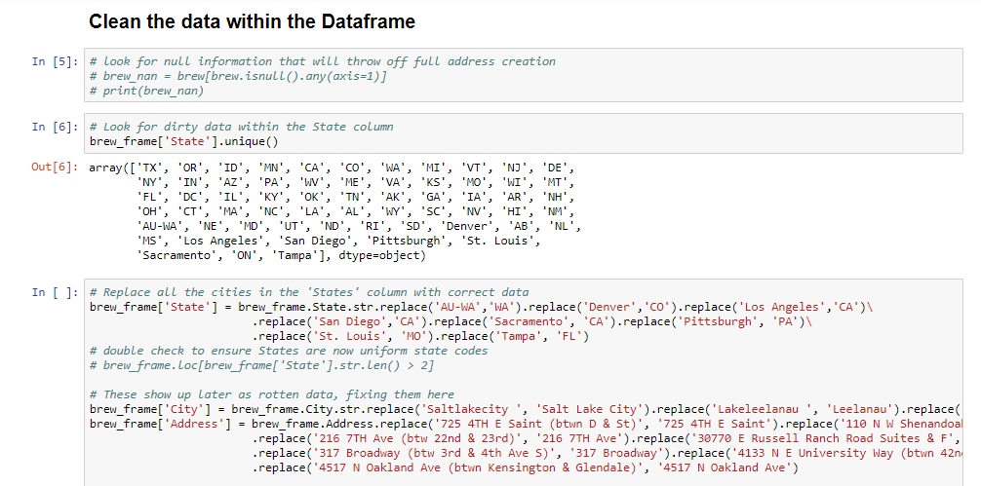
Example Code from Jupyter Notebook

